Slide 2
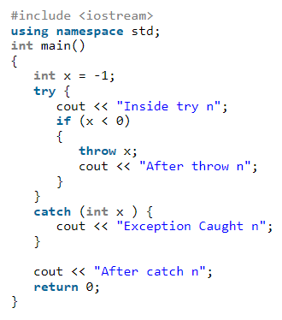

Slide 3
Inside try
Exception Caught
After catch

Slide 4
What should be put in a try block?
1. Statements that might cause exceptions
2. Statements that should be skipped in case of an exception

Slide 5
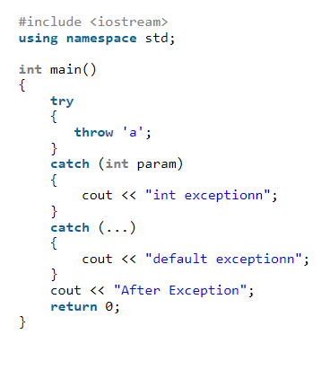

Slide 6
default exception
After Exception

Slide 7
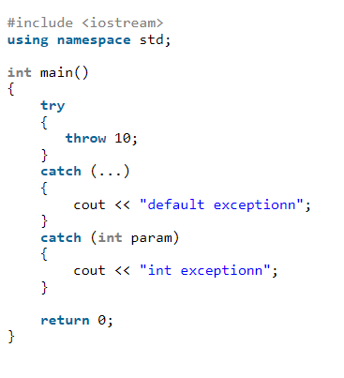

Slide 8
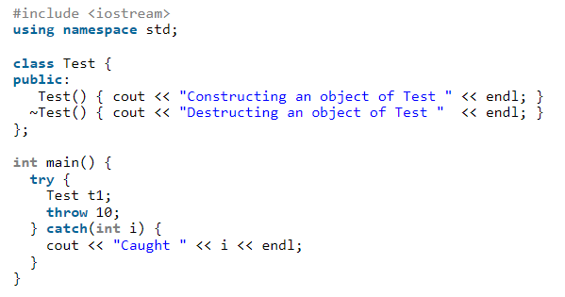

Slide 9
Constructing an object of Test
Destructing an object of Test
Caught 10

Slide 10
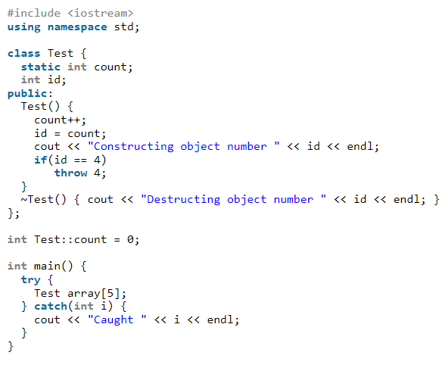

Slide 11
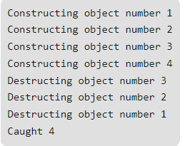

Slide 12
#include <iostream>
using namespace std;
int main()
{
try
{
try
{
throw "msg";
}
catch (const char *x)
{
cout << "Inner Catchn";
throw 1;
}
}
catch (int x)
{
cout << "Outer Catchn";
}
return 0;

Slide 13
#include <iostream>
using namespace std;
int main()
{
try
{
try
{
throw "msg";
}
catch (const char *x)
{
cout << "Inner Catchn";
throw ;
}
}
catch (const char *x)
{
cout << "Outer Catchn";
}
return 0;
}

Slide 14
#include <iostream>
using namespace std;
int main()
{
try
{
try
{
throw "msg";
}
catch (const char *x)
{
cout << "Inner Catchn";
throw ;
}
}
catch ( int x)
{
cout << "Outer Catchn";
}
return 0;
}s

